Slide 1

Slide 1
Best neighborhood for grocery Warehouse in Scarborough area
IBM Data Science Capstone Project
Nirav Patel

Slide 2
Introduction
This presentation is for the final project from the IBM Data Science Professional Certificate program.
The goal of this project is to use the tools and skills acquired through the different courses to develop and idea to leverage the Foursquare location data to explore or compare neighborhoods or cities of our choice in order to come up with a problem that you can be solved using the Foursquare location data.

Slide 3
Background and Business Problem
Loopmark is a Toronto based company focusing on providing consulting services for the commercial real estate. Here we will consider, we are working for the Logomark.
Jon, a client wants to move his warehouse for his business from Ottawa to Toronto. To be specific he is looking for a neighborhood in Scarborough area of the Greater Toronto Area.
He wants to be in the area close to groceries and retail market, as his business defines those needs.

Slide 4
Data
https://en.wikipedia.org/wiki/List_of_postal_codes_of_Canada
Foursquare API information on venue categories, location data, ratings and more
Geo locational information about the neighborhoods in Scarborough
The data collected from all these files will be cleaned and converted to python supported file with the use of pre-defined libraries from the Python.

Slide 5
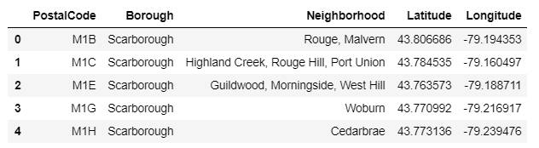
Methodology
Import data for the Toronto neighborhoods with latitude and longitude

Slide 6
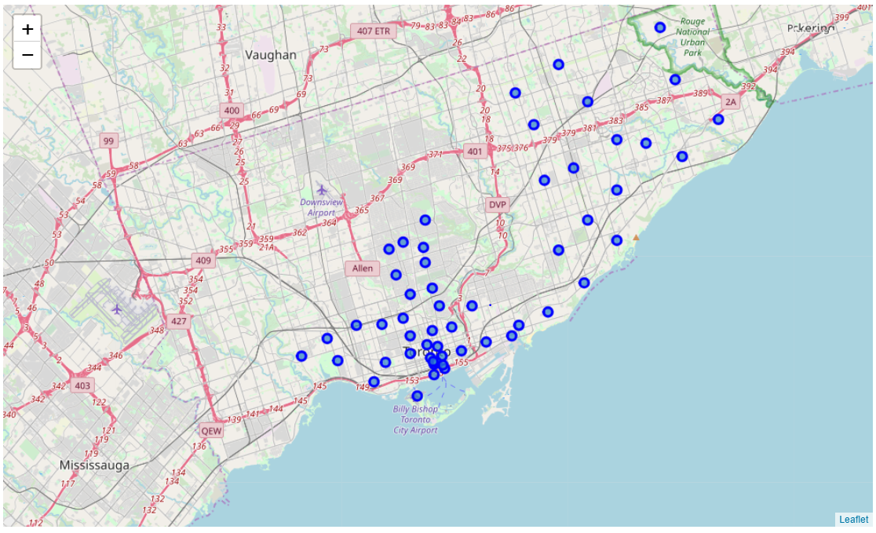
Filter data by borough (Downtown Toronto, East Toronto, West Toronto, Central Toronto, Scarborough)

Slide 7
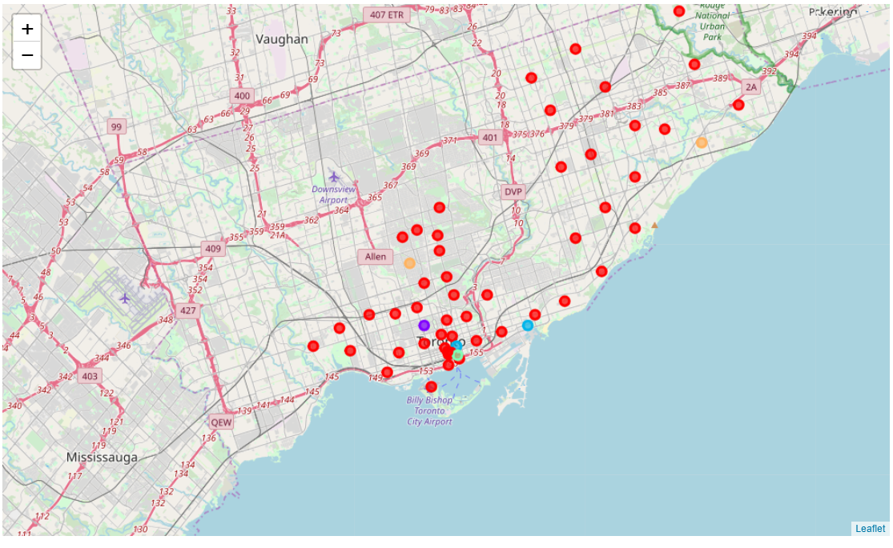
K-mean Cluster to segment all 55 neighborhoods into 5 clusters

Slide 8
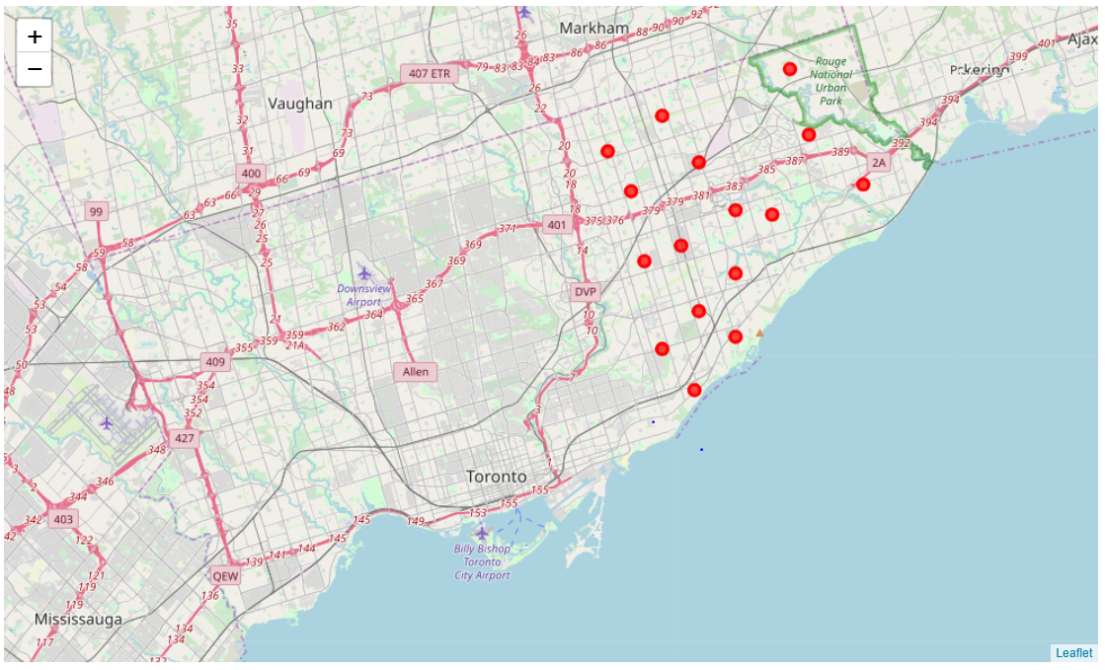
Now We have 11 possibilities with the borough of Scarborough and are part of Cluster 0

Slide 9
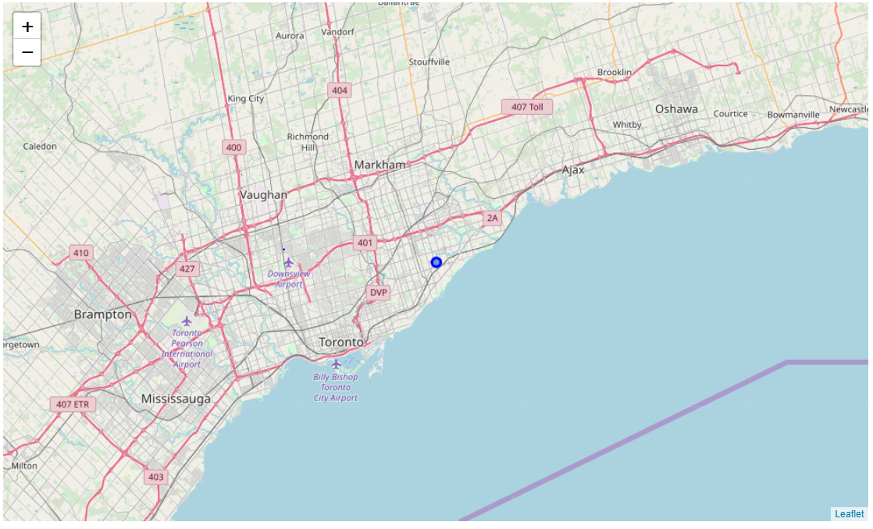
Another condition to satisfy is, it needs to be around the groceries stores.
The only candidate/venue which satisfies the requirements is candidate 5 (Scarborough Village).

Slide 10
Results
By satisfying each of the requirement step by step as explained, we only find one neighborhood (Scarborough Village) which has the well rated grocery stores too.
Conclusion
The result from this project has limitations. According to the scope of the project and available resources (Time and Skills in this case) we had to make some assumptions here, like limited number of venues and radius of 500 meters.
According to our analysis, the best neighborhood is Scarborough Village.
__________________________ Thank You _______________________________________

